Slide 1

Session 8
Evaluating Library Effectiveness and Impact: Three Perspectives
Jeff Trzeciak, Peter Sidorko and Dianne Cmor

Slide 2
Strategic Plan: Foundations for Assessment
Strategic Planning Steering Committee
Process
Peer Library Analysis
Trends
Public and Staff Input

Slide 3
Strategic Planning @ NPL
Steering Committee
Comprised of
  5 staff,
  Library Director and
  4 Trustees
Ongoing meetings scheduled every other week

Slide 4
NPL Strategic Planning Process
Environmental Scan
One of the best ways to get ideas about what we might want to create is by looking outside of ourselves for perspective and inspiration.
Peers and aspirant peers
Thematic “deep dives”
User perspectives
Values/Vision/Mission
It’s essential to define our shared values and use them to clarify the essential elements of our aspirational future, the kind of library where internal and external stakeholders thrive.
Values
Mission
Strategic Directions
Strategy is planned change, making choices about our desired future and identifying the critical few priorities toward which resources will be directed in order to advance the institution.
Strategic Priorities, Goals, Selected Initiatives
Vision
Community priorities
Board
Mtg
Board
Mtg
August-September
September-October
July-August

Slide 5
Guiding Principles
Privileges voices of those outside the institutional structure
Faces outward
Operates from trust in abundance
Initiative, being proactive to go beyond expectations
Emphasizes relationships
Encourages sharing
Change is incremental, ongoing, and ubiquitous
Focus on “why we do it” instead of “what we do”

Slide 6
Aspirations
Everyone can see a role for themselves at NPL
Create a culture of teamwork
Position NPL as a leader in the state
Build trust and authentic engagement with staff
Set high standards, and develop a system for assessing our work
Be aspirational
Develop a mission that connects with each staff member
Build a diverse and inclusive workforce that reflects our community
Be innovative
Show up in our communities as our very best
Create a positive and welcoming environment for everyone
Be transparent in our work, and be both subjective and objective when needed

Slide 7
Best Practices
What are some of the “best practices” from previous NPL planning processes that you want to be sure to incorporate this time?
Create something that is not overly engineered at a high level
Find a balance of voices beyond senior staff
Create something that is more than a doorstop
Include a scorecard or dashboard that helps demonstrate progress
Communicate throughout our work to keep people informed

Slide 8
Peer and Aspirant Peer Libraries
Oakland Public Library, CA
Carnegie Library of Pittsburgh, PA
New Orleans Public Library, LA
St. Louis Public Library, MO
St. Paul Public Library, MN
Jersey City Public Library, NJ
Norfolk Public Library, VA
Arlington County Public Library, VA
Birmingham Public Library, AL
Rochester Public Library, NY
Detroit Public Library, MI

Slide 9
Peer Library Analysis
Identified 10 libraries to examine and identify points of interest
Committee members finalizing reports to share
Identifying innovative work and potential influence for NPL
Birmingham Public Library
Carnegie Library of Pittsburgh
Population of 210,000, 71% African American
19 libraries
Website includes staff created content
Extensive digital collection, including Birmingham African American Experience
Annual staff innovation competition
STEM robotics programs for teens
Population of 303,625
Significant volunteer hours
Extensive public service hours
Diversified income sources
Website includes photos of staff, as well as images of new books and more
2.9 million library visits (2015)
3.9 million items borrowed (2015)

Slide 10
Library Trends and Developments
  To determine some library trends and contemporary developments, we can study peer/aspirant peer institutions
      Who are NPL peers and aspirant peers?
      Criteria for choosing:
    Have particular strengths and reputation for doing innovative work
    Roughly similar size/scale as NPL
    Institutions that are a bit bigger or differently resourced and are able to do things that NPL is not yet doing
    Mix of peer and aspirant peers
    Communities with similar demographics\
    Mayor’s peer cities
    Chamber peer cities
    Libraries dealing with similar issues
http://www.urbanlibraries.org/library-members-pages-49.php

Slide 11
Public Forums
7 sessions held with 106 participants
Spanish language translator provided
Survey in English, Spanish and Portuguese
Led by consultants DeEtta Jones Associates
Questions asked about the City of Newark, individual communities and neighborhoods, and the Newark Public Library

Slide 12
Public Forums, cont’d
Several strong themes emerged across all sessions, and in the online survey
  Pride in community with desire to improve and strengthen
  Major social service needs and need for multi-generational support services
  Need for increased visibility of Newark Public Library
  Leadership for Newark’s future
  Specific Needs for a better library system

Slide 13
Staff Forums
77 staff attended (out of 100)
Facilitated discussion of key library and community issues
Several themes emerged (Information not yet analyzed)
  Programs and Events
  Great opportunities like SAT Prep and ESL classes
  Need to be able to scale up and market well
  Facilities
  Safe space with welcoming staff
  Need to maintain better and make significant improvements
  Human Resources
  Staff go above and beyond every day
  Need for recognition, equitable and fair systems and policies

Slide 14
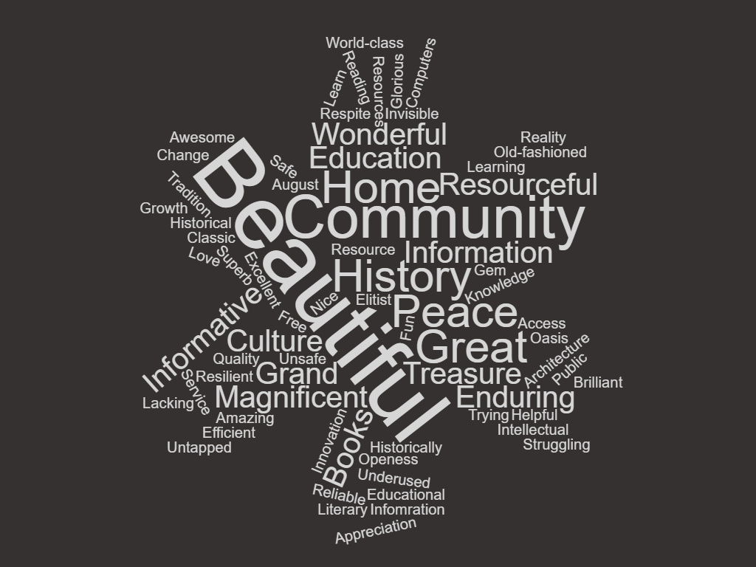
Online responders were asked to share one word that comes to mind when they think of The Newark Public Library.

Slide 15
Build community
  Community members value Newark’s past, present and future.
  Community members acknowledge Newark’s challenges.
  NPL is seen as a safe and secure place for the community.
  NPL can address community challenges.
Address social needs with supportive services
  Strengthen supportive services for children and youth.
  Strengthen supportive services across the generations.
  Provide the community with necessary life skills.
Respond to specific community wants and needs
  NPL has demonstrated value to the community.
  NPL can leverage its strengths.
  NPL can make improvements to satisfy community wants and needs.
Increase the library’s visibility and impact
  Address the challenge to change perceptions.
  Enhance outreach, marketing and promotion.
Provide leadership for a Newark’s future
  Create more impactful collaborations and partnerships.
  Facilitate organizational and culture change.
Strategic Areas for Planning

Slide 16

Strategic Area #1 - Build Community
“The diversity of people - not just color or nationality, but age, religion, economic level, lgbt, artists and professors, clerks and firemen... Also, its rich history and architecture revealed in its parks and statues, churches and bridges, train stations and other wonderful old buildings - and its amazing institutions including the library, NJ Historical Society, Newark Museum, Mosque Theater, etc.”
“Residual of old and current drug problems; violence within communities; lack of employment opportunities; political corruption, both local and regional; municipal failure to reinvest in institutions that create a sense of belonging and pride.”
“The library is another place to call home.”
“The library’s role is to level the playing field. No matter who you are, you can come to the library and be served. People can come to the library to find community, safety and hope.”
Community members value Newark’s past, present and future.
Community members acknowledge Newark’s challenges.
NPL is seen as a safe and secure place for the community.
NPL can address community challenges.

Slide 17
Strategic Area #2 - Address Social Needs with Supportive Services
“Our neighbors have hope because the library is willing to make changes. We need to have strong programs and relationships with schools, which then introduces positive experiences in other pockets of our community. We need to nurture people’s thoughts and help them with fundamental betterment.”
“More opportunity for intergenerational learning.”
“Would like to see people that can help with grants, small business loans, help with resources that can help with personal matters, entrepreneurship resources (resources to bring people together 1 - 2x monthly).”
“The Library need's a Social Services Department to help all the homeless.” people with Mental Health issues.
Supportive services for children and youth.
Supportive services across the generations.
Provide the community with needed life skills.

Slide 18
Strategic Area #3 - Respond to Specific Community Wants/Needs
“The library is one of the most important aspects of our community.”
“We LOVE our library!”
“The friendliness of it's staff, and the manner in which they go all out to be helpful….”
”Inside and out, the Main Branch is one of my favorite buildings in the world. Also, incredible programs such as the Kara Walker and Zadie Smith talks often rank as highlights of my year.”
”Better access for parking, staying open later during the work week.”
“I love when there are lectures and events. I wish they would start at 6:30 when parking is free and more plentiful. A lot of times I do not come since I would enter late and interrupt.”
NPL has demonstrated value to the community.
NPL can leverage its strengths.
NPL can make improvements to satisfy community wants and needs.

Slide 19
Strategic Area #4 - Increase visibility & impact
“Lack of awareness of location and resources is keeping people from using the library.”
“It’s a missed opportunity because people don’t know what is here to use or even the rooms can be used for community.”
“Have an outreach team to go to disenfranchised community to get the word out about the library and what it offers.”
“Something visual on the outside of the buildings to make them more recognizable.”
“It would be helpful if the Library conducted outreach to the Colleges in the City (big or small) to connect with the students. This is to offer an additional resource outside of the College.”
Address the challenge to change perceptions.
Enhance outreach, communication, marketing and promotion.

Slide 20
Strategic Area #5 - Provide leadership
“They have some amazing collections that I rely on. They really are valuable to my work and to the history of our city.”
“The Library is and should continue to be a place that builds bridges.”
“Collaboration with international libraries to share information and programing best practices.”
“It's the largest library system in the state. Professionalism. It's multicultural.”
“Its prevailing professionalism and striving to make progress.”
“I want to see the library connect more to the other organizations in the city.”
Collaborations and partnerships.
NPL organizational and culture change.

Slide 21
Strategic Plan Implementation Team
Reporting to the Director, the Strategic Plan Implementation Team is responsible for advancing and supporting the library’s strategic plan through effective execution of its key initiatives.
The team will:
  Identify objectives that support the strategic directions and goals;
  Communicate implementation timelines;
  Identify and implement a process of continual assessment based on outcomes; and
  Implement a process on-going staff and community feedback and reporting.
The Chairs will:
  Report progress monthly to the Leadership Team;
  Develop written reports to be shared with the Board of Trustees; and
  Present at least once annually to the Board of Trustees.

Slide 22
Strategic Plan Implementation Team
1). Provide Welcoming, Safe and Vibrant Environments
Chair and Leadership Team Liaison: George Williams
Members: Ana Herrera, Shileen Shaw, Monica Malinowski, Isidra Myricks, Sandra Jones, James Burse
2). Enhance and Promote Newark Public Library’s Distinctive Special Collections
Chair: Tom Ankner
Leadership Team Liaison: Ingrid Betancourt
Additional Members: Dale Colston, Nadine Sergejeff, Yesenia Lopez, Michael Novakovic
3). Strengthening Digital Literacy Skills for All:
Chair: Joy Robinson
Leaderhip Team Liaison: Nicole Butler
Members: Joy Robinson, Diego Quintero, Cavelle Dixon, Ranssel Rodriguez, Jim Capuano
4). Contribute to the Personal Growth and Well-Being of All Newarkers:
Chair: Leslie Kahn
Leadership Team Liaison: Rod Jefferson
Membership: Kirsten Giardi, Nayda Santiago, Paula Baratta, Leslie Kahn, Aaliyah Bowen, Annecy Webb, Jorge Rodriguez, Natalie Guiones, Rashida Williams
5). Nurture Newark’s Youth and Families:
Chair: Susan Lazzarri
Leadership Team Liaison: Heidi Cramer
Members: Maisy Card, Cynthia Becker, Tara Murphy, Leala Arnold, Natasha Osborne, Aurelia Rodriguez, Paul Volpe

Slide 23
Next Steps
Timelines
Continual Feedback
Board reporting
Measureables

Slide 24
The University of Hong Kong
1 Assessment of Library Performance
  Biennial user survey (Insync)
2 User Experience Research
  Visitors and Residents
  Behavioural Mapping
  Non-participant Observation

Slide 25

1 Assessment of Library Performance:
Biennial User Survey
Australia, New Zealand, Singapore, HK, North America
ServQual
Importance vs Performance
Likert Scale (1-7)
Gap analysis (28 questions)
Freeform comments
Benchmarking tool
Performance improvement tracking

Slide 26
Biennial User Survey
Communication
Service Delivery
Facilities & Equipment
Information Resources
Extras??

Slide 27
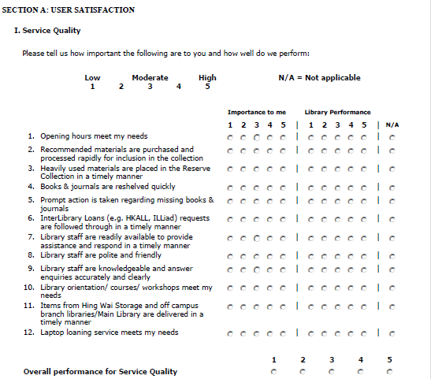
Sample “Gap” Survey

Slide 28
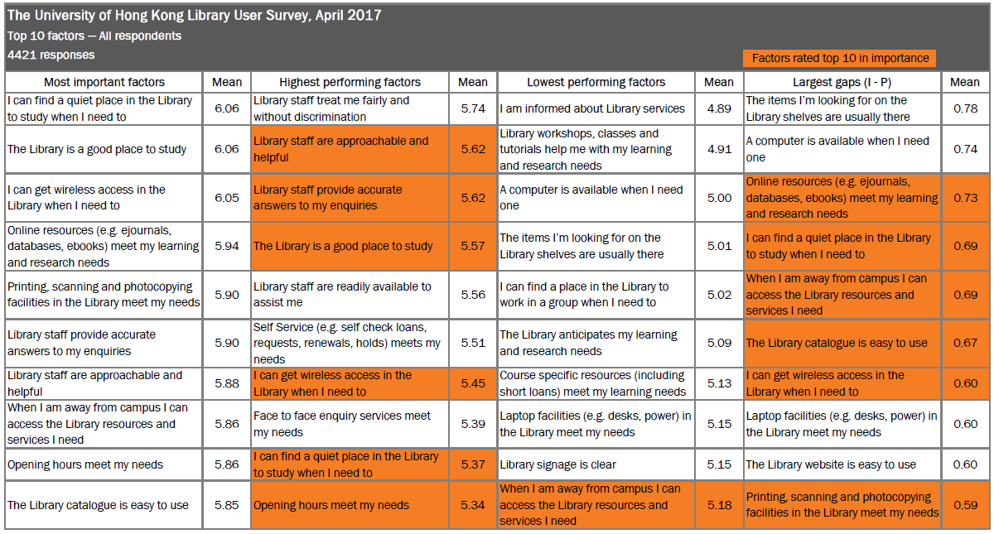
Top 10 Factors

Slide 29
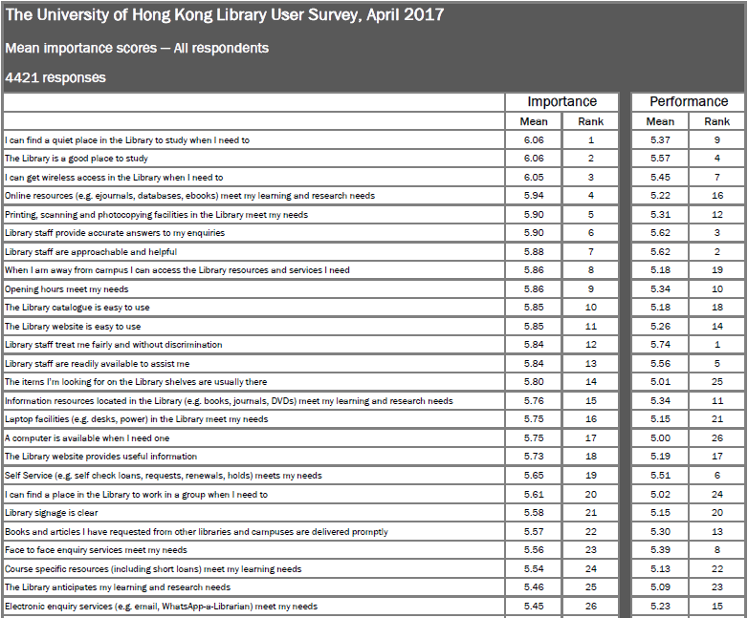
Ranked by “Importance”

Slide 30
Ranked by “Performance”

Slide 31
Ranked by “Gap”

Slide 32
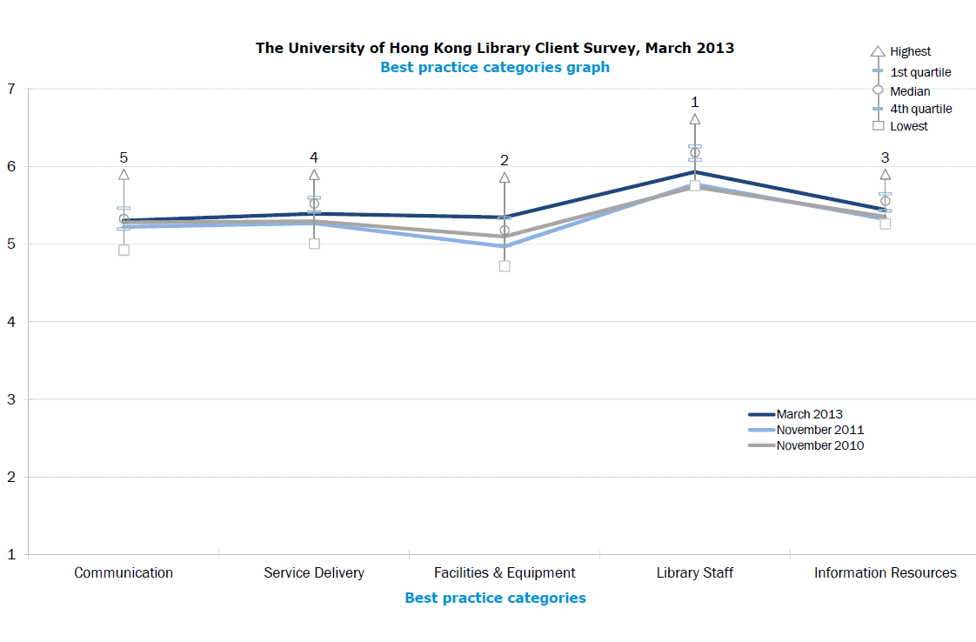
Tracking over time

Slide 33
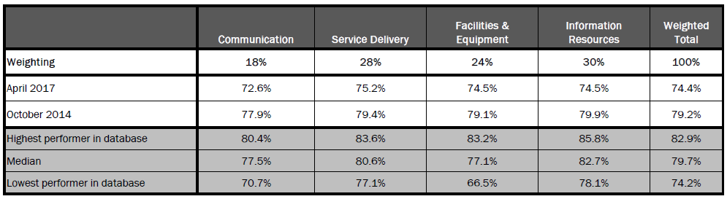
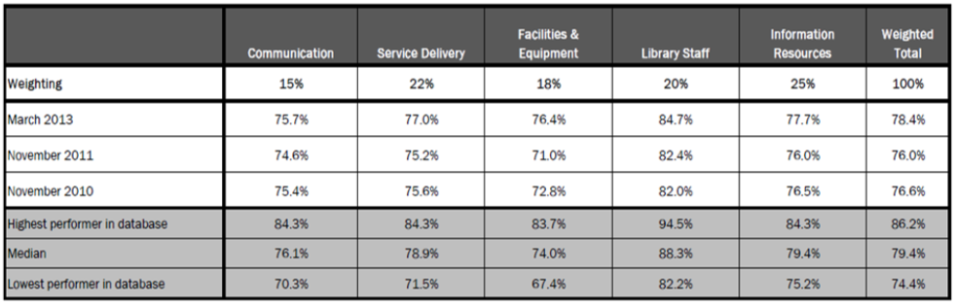
Performance tracking and benchmarking

Slide 34
2 User Experience (UX) Research
Visitors and Residents
Behavioural Mapping
Non-participant Observation

Slide 35
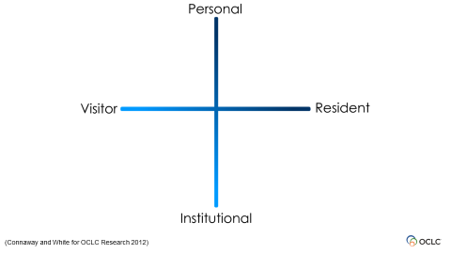

Slide 36
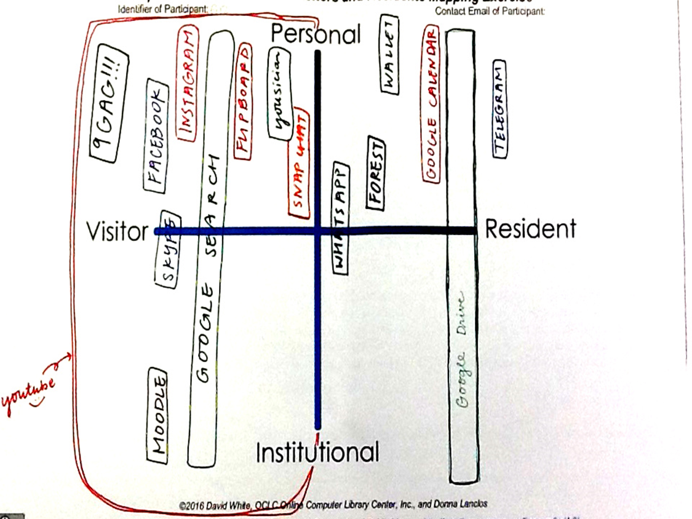
HKU 1st Year
Undergrad

Slide 37
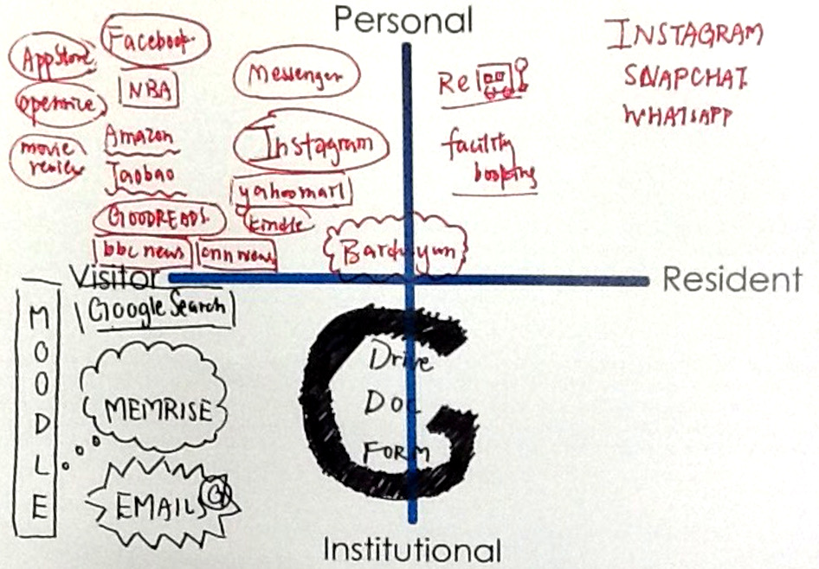
HKU 1st Year
Undergrad

Slide 38
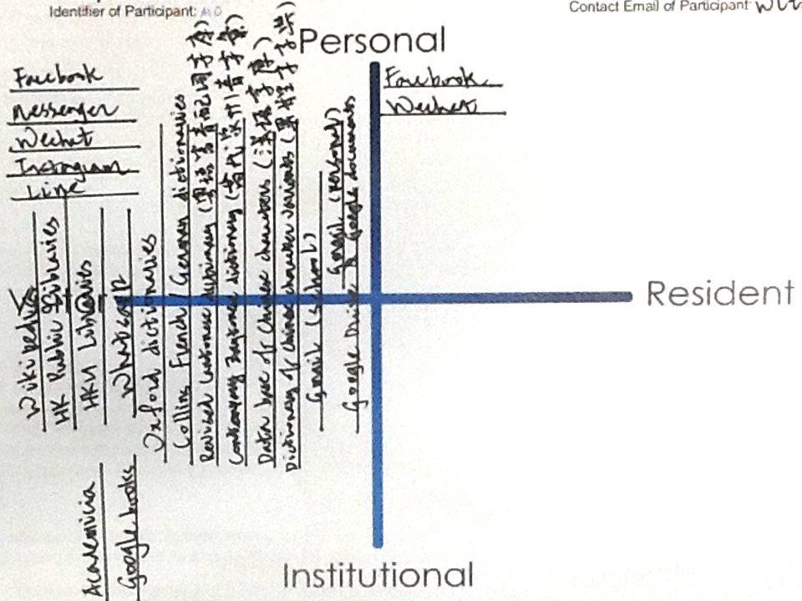
HKU Later
Year Undergrad

Slide 39
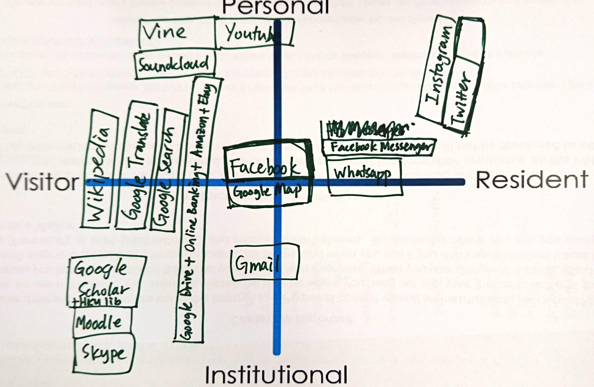
HKU Later
Year Undergrad

Slide 40
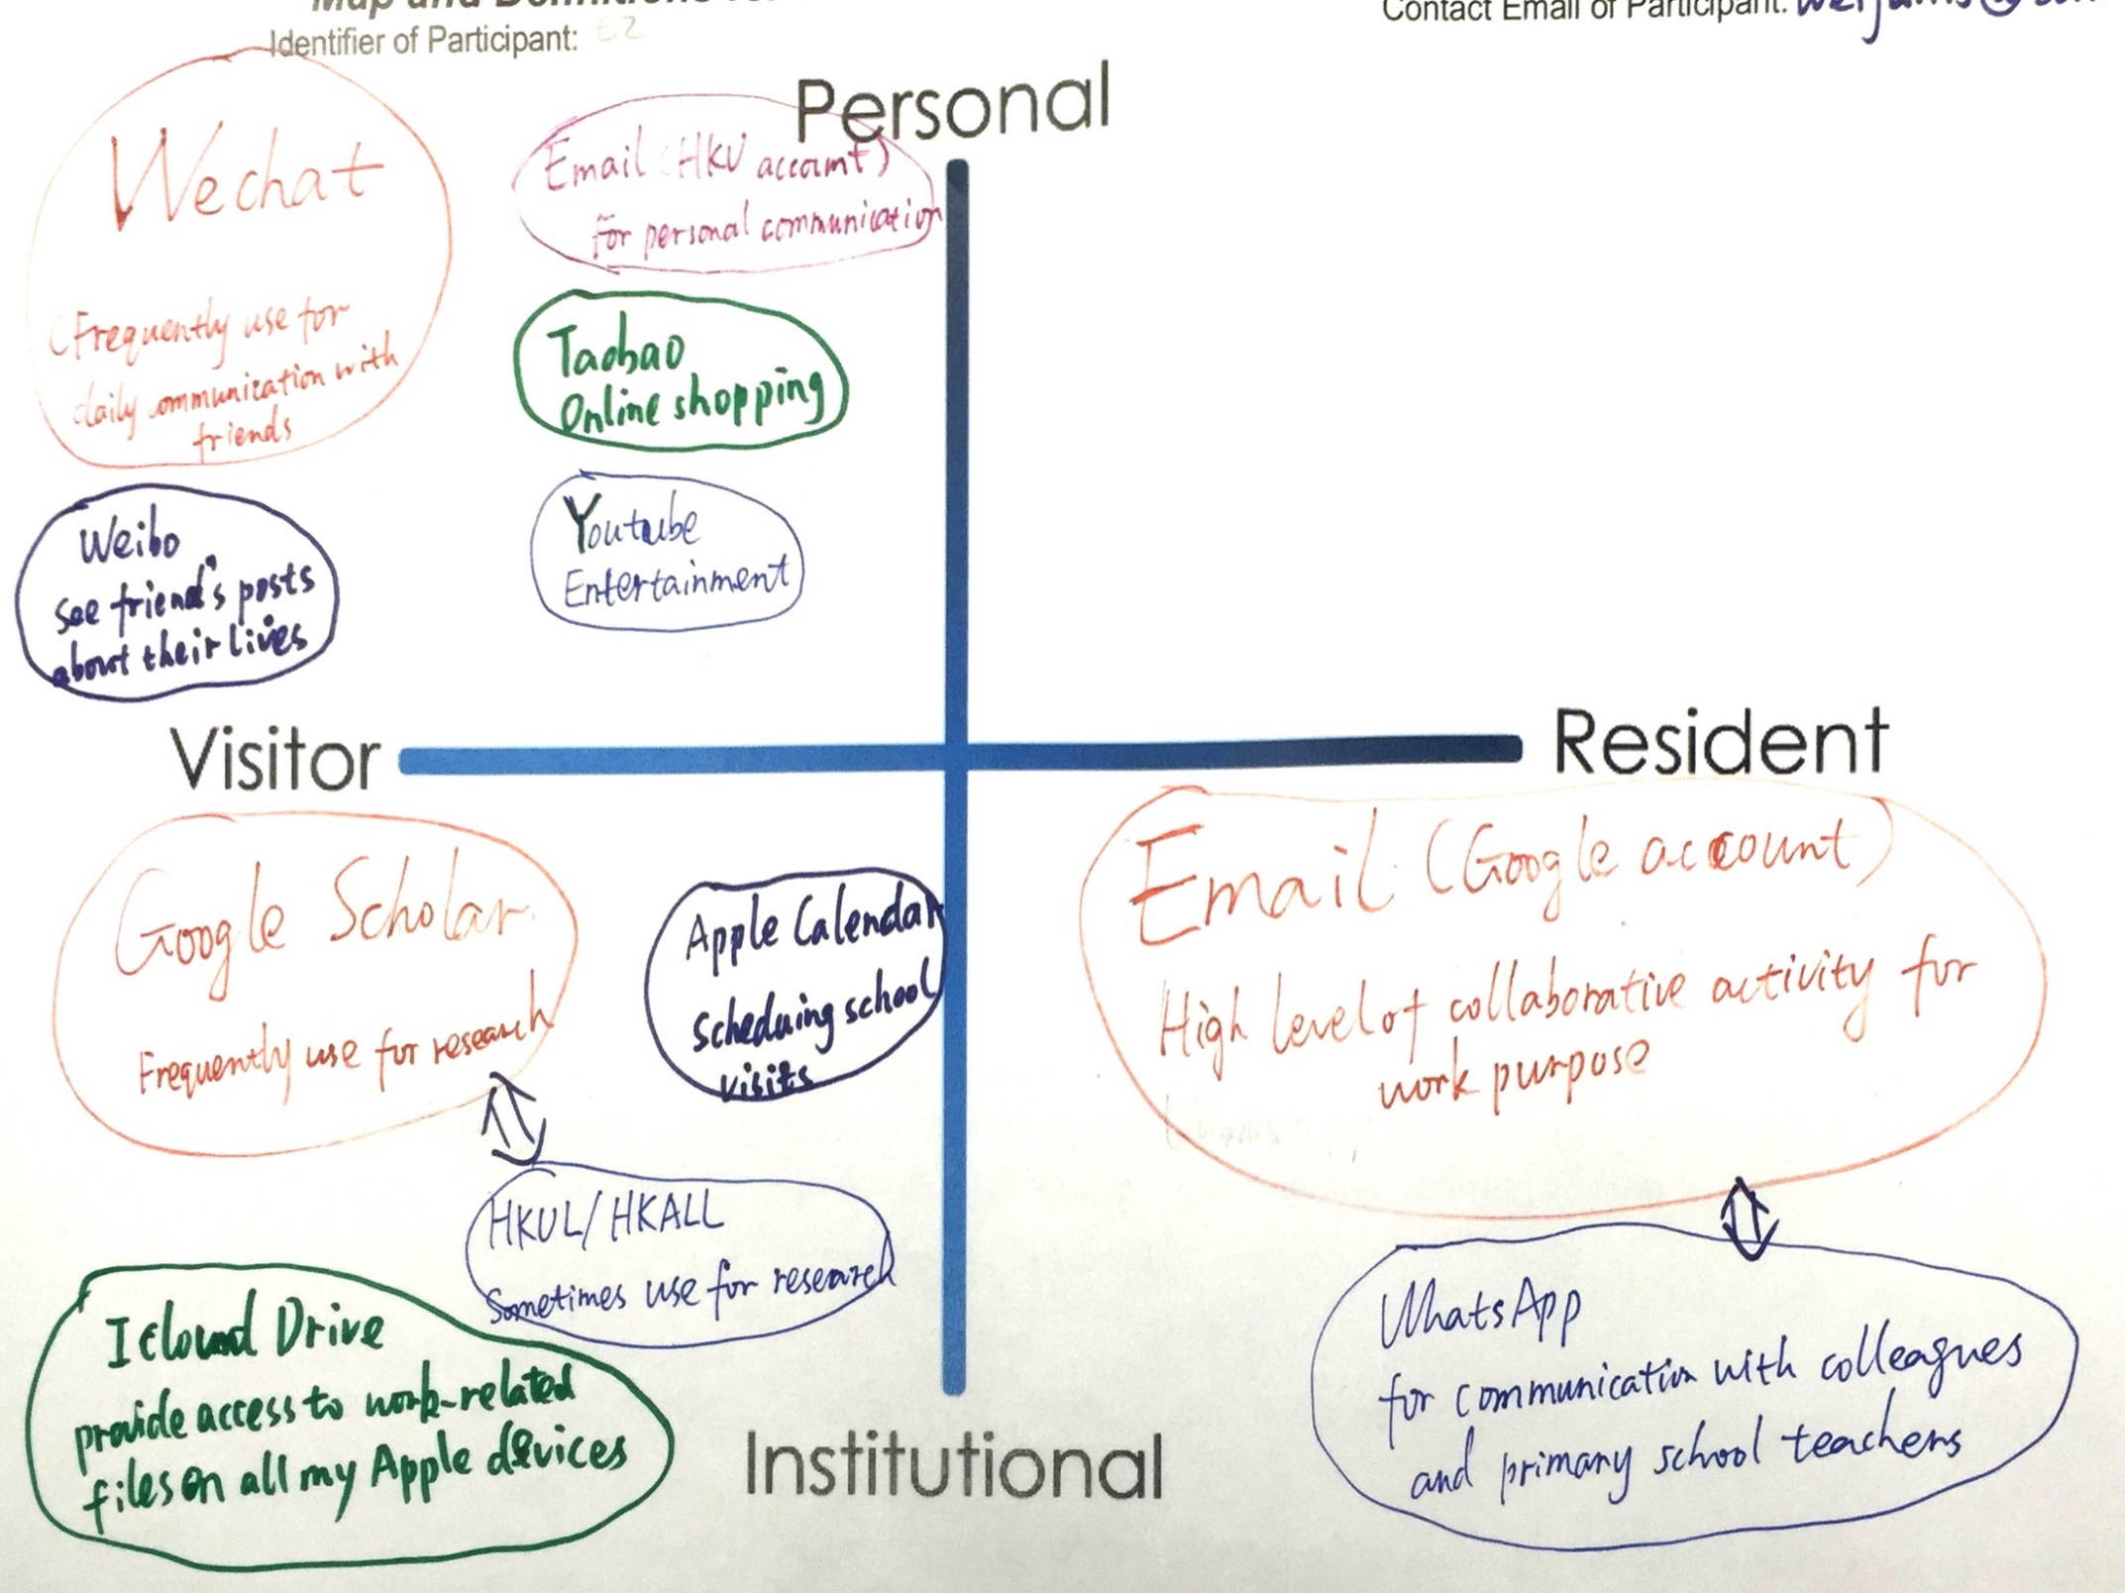
HKU Faculty

Slide 41
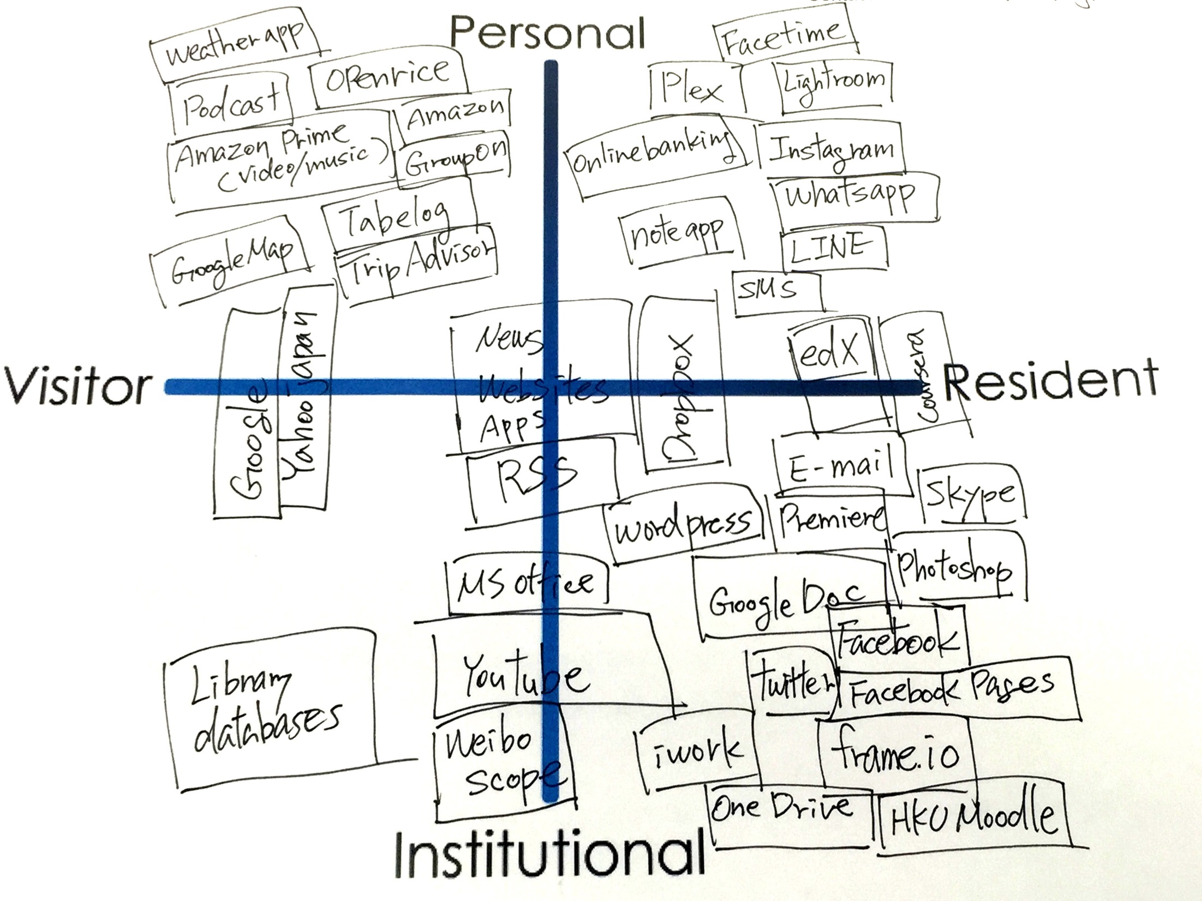
HKU Faculty
Notes:
HKU, faculty research and/or scholar
Frameio can communicate with people not in the same places/environment
FB mostly for work, don’t have separate accounts as only for work.
News is a big part of my life.
Post news on FB and share it with students and friends. Post a lot of FB pages
Go to library website directly, not via google
John: library web site is not confusing but some journals that library may not subscribe to are in Google Scholar and we can see more. Google Scholar has far more citations than the library.
Use a lot of tools, Twitter & FB - most people use for private communication. I use them for work/professional communication.
Personally I use Line and share photos via cloud. FB is purely for work
My wife share everything on FB, like kids’ photos

Slide 42
Notes:
These websites/activities represent the “dominant genes” of the two groups. Note the institution-specific items (“HKU Portal”, “MyUCLA”, “CCLE”) and region-specific items (“Taobao”).

Slide 43
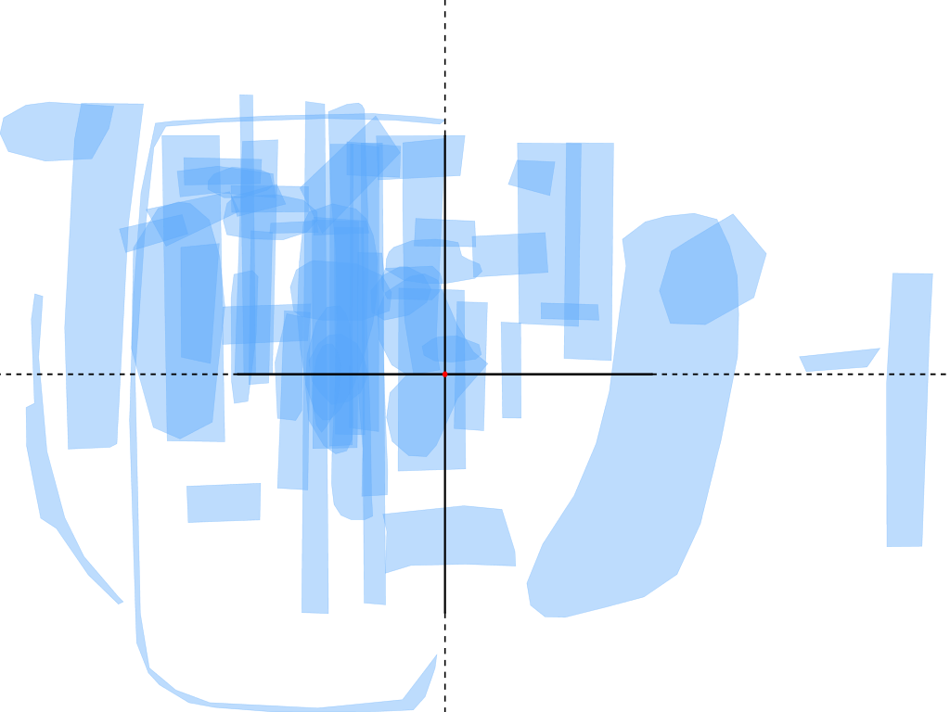
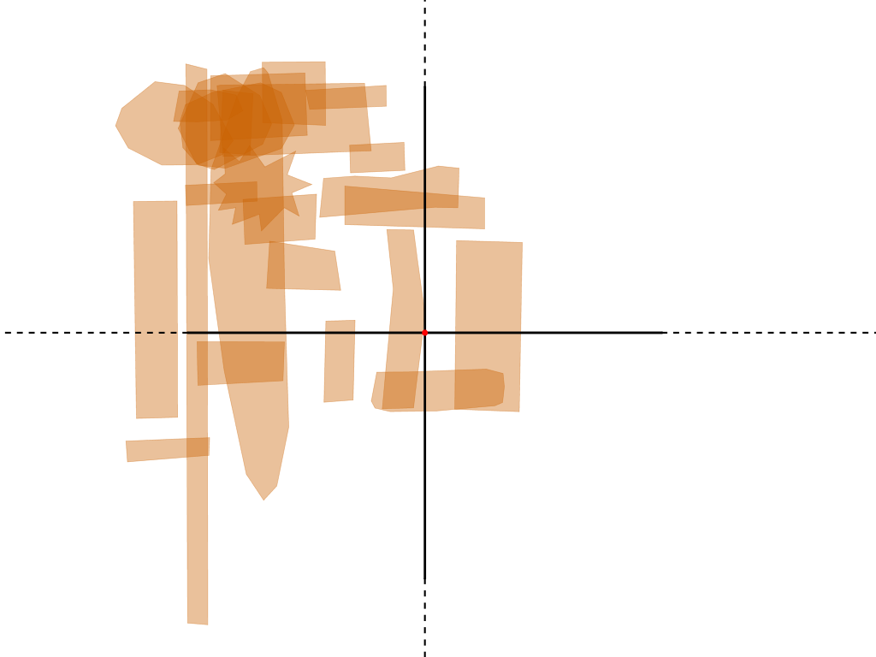
YouTube
P
P
V
R
V
R
I
I
HKU
UCLA
Notes:
YouTube use tends to cluster in the Visitor/Personal quadrant with some Institutional use in both cases. HKU participants tend to engage as a Resident more frequently than UCLA participants.

Slide 44
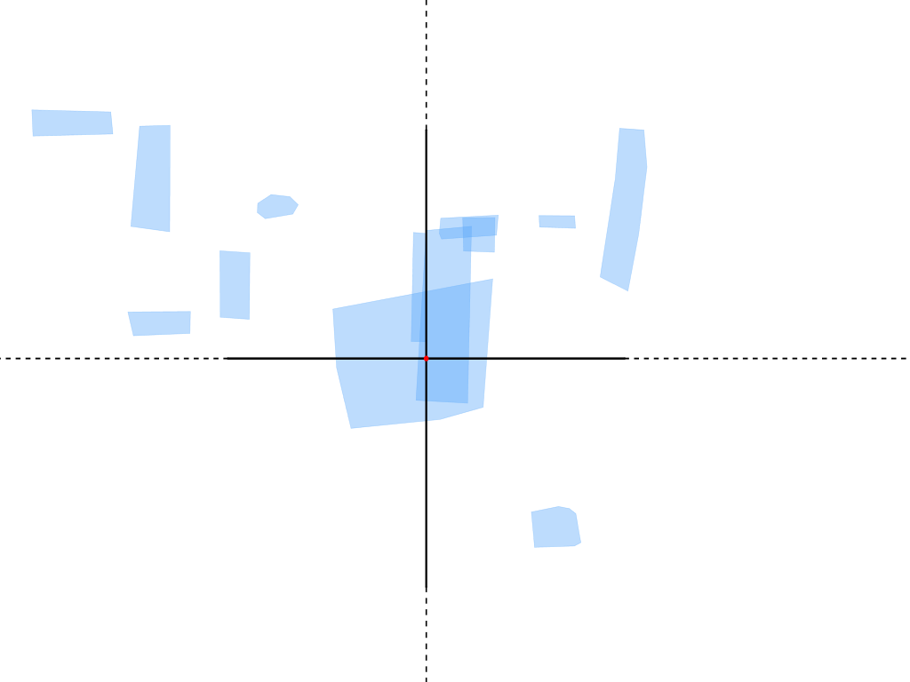
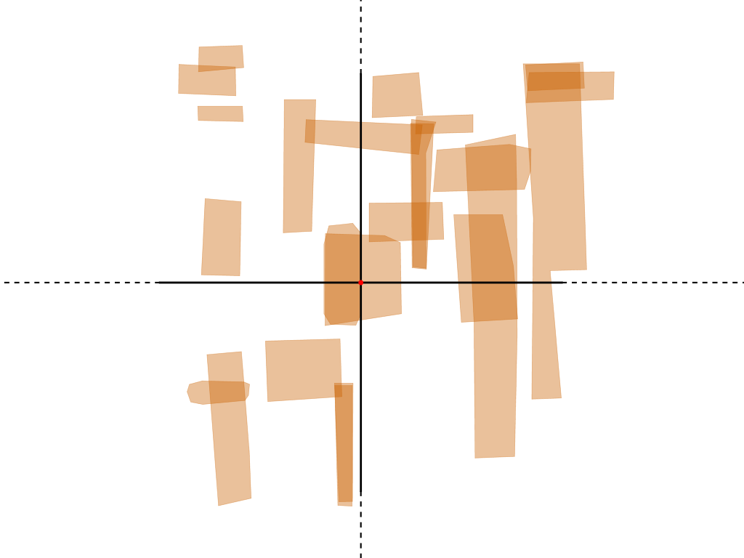
Twitter
P
P
V
R
V
R
I
I
HKU
UCLA
Notes:
Twitter use more popular among UCLA participants.

Slide 45
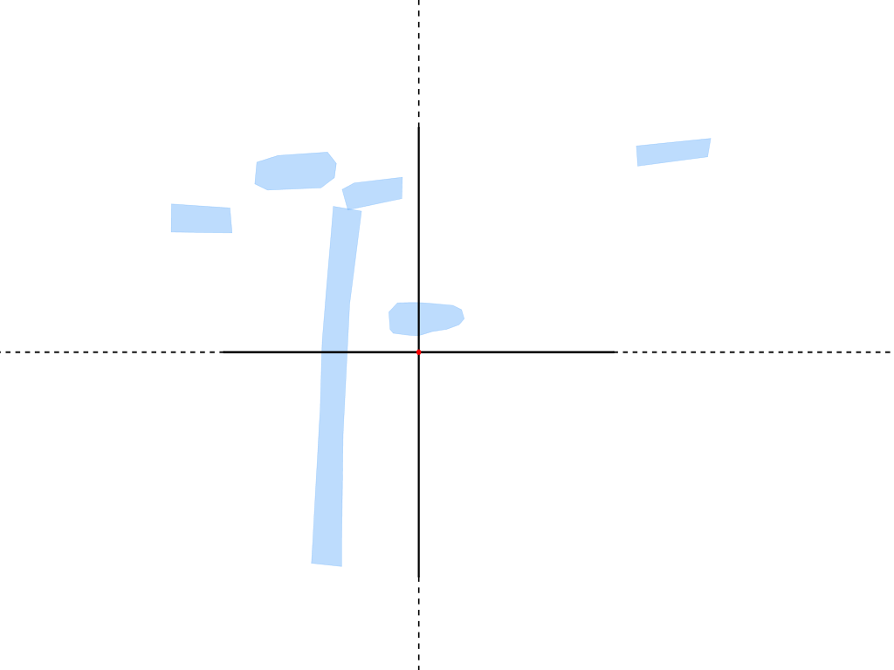
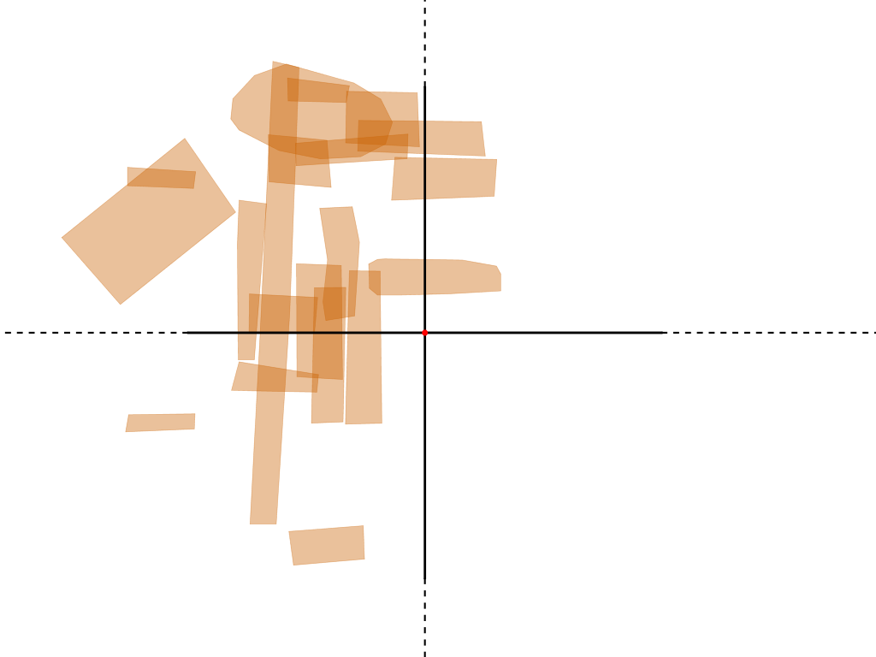
Amazon
P
P
V
R
V
R
I
I
HKU
UCLA
Notes:
Amazon is mostly Visitor use, mostly Personal. UCLA participants tend to use it much more than HKU participants. (HKU possibly relies on Taobao for this niche.)

Slide 46
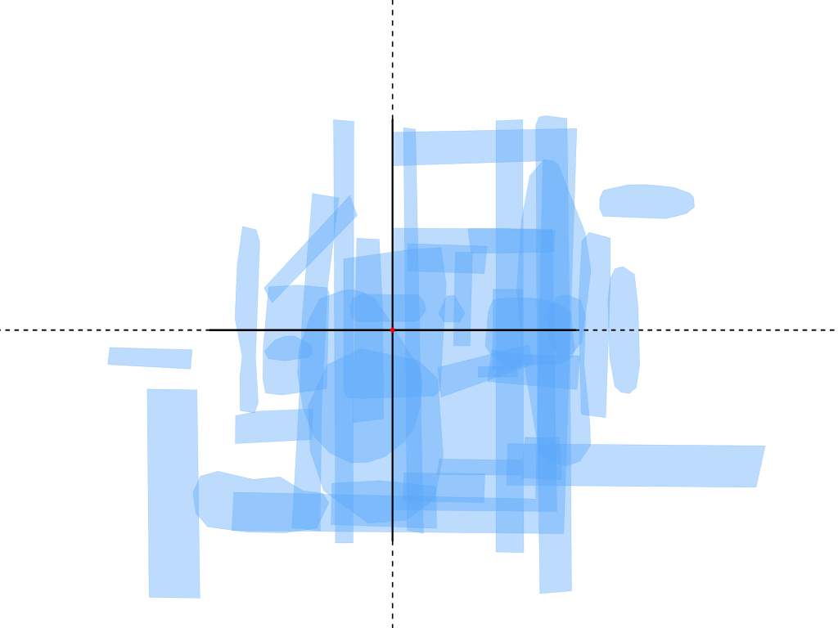
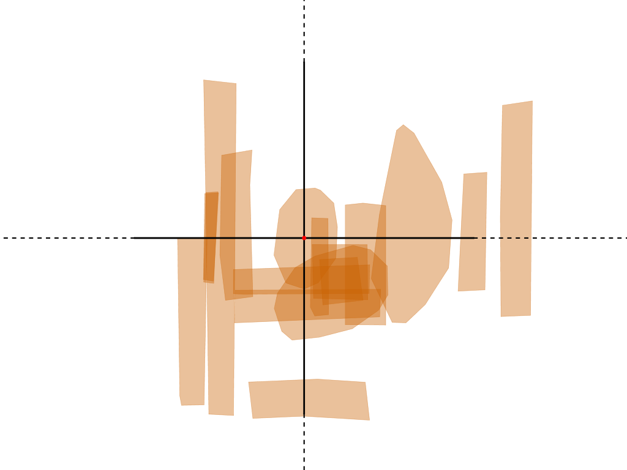
Google Drive
P
P
V
R
V
R
I
I
HKU
UCLA
Notes:
Google Drive. Lots of use among both groups.

Slide 47
Findings from Visitors and Residents Research
  We learned about the activities our users are engaged in and also how they are engaged
  Understanding how our users engage with technology (visitor vs. resident, personal vs. institutional) informs changes and improvements to our service design
  We will continue with further studies that help us to learn about our users (e.g. user experience research including behavioural mapping and non-participant observation)
  Modify our biennial survey to incorporate aspects of this research and behavious

Slide 48
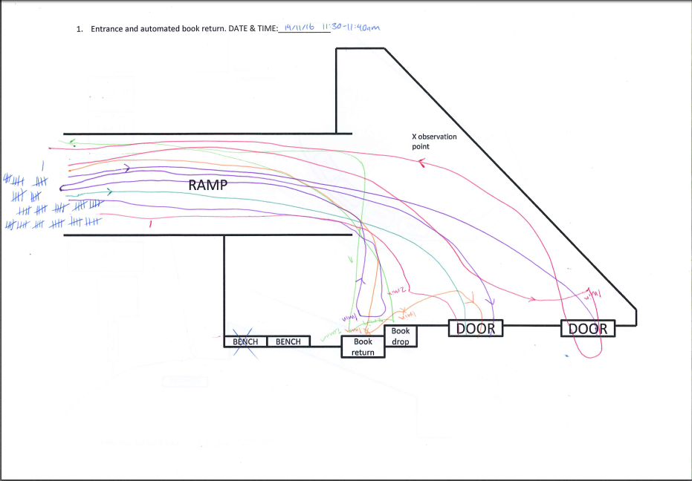
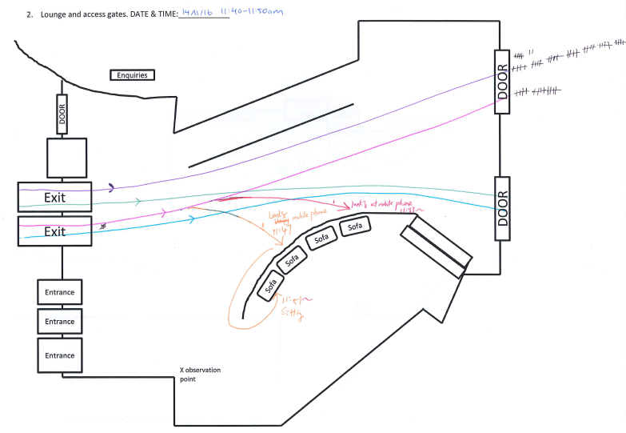
Behavioural Mapping: Interpretation
230 minutes of behavioural mapping data collected
Data collected at 5 sites: 1) Main entrance 2) Lounge 3) Self-service collection 4) Exhibition area 5) Service counters
Data collected 11:30am – 12:00pm and 4:30pm – 5:00pm
Notes:
Behavioural mapping at HKUL

Slide 49
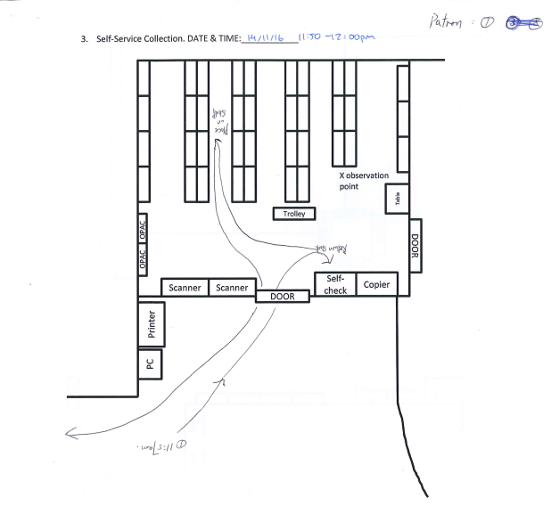
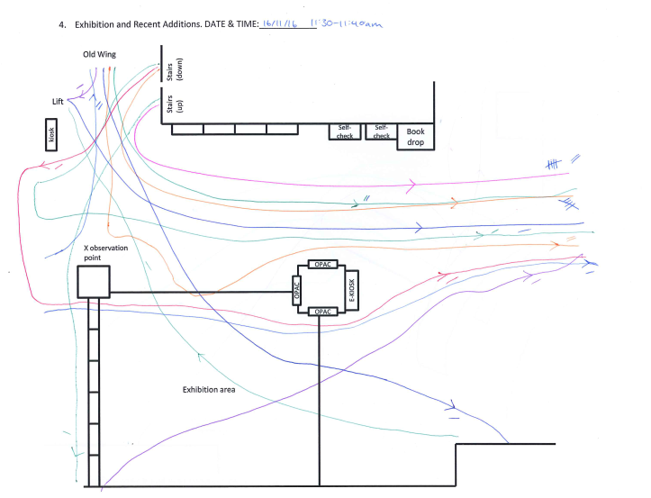
Behavioural Mapping: Interpretation

Slide 50
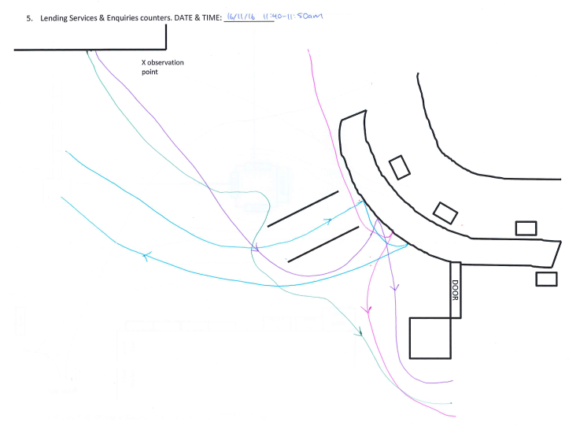
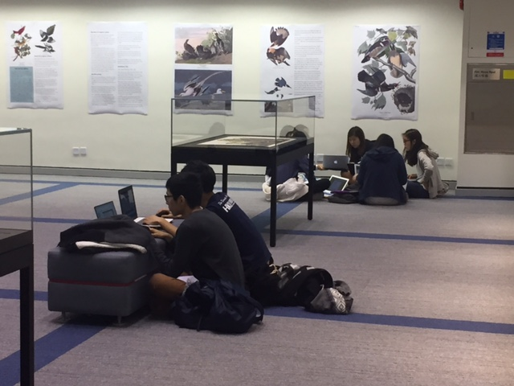
Behavioural Mapping: Interpretation
Preliminary findings:
Confirm some information: e.g. preference for one of the sliding glass doors, confusion over manual and automated book returns
Many users enter the Library and go directly to the new wing staircase
Identified places users commonly wait, sit, and stand.

Slide 51
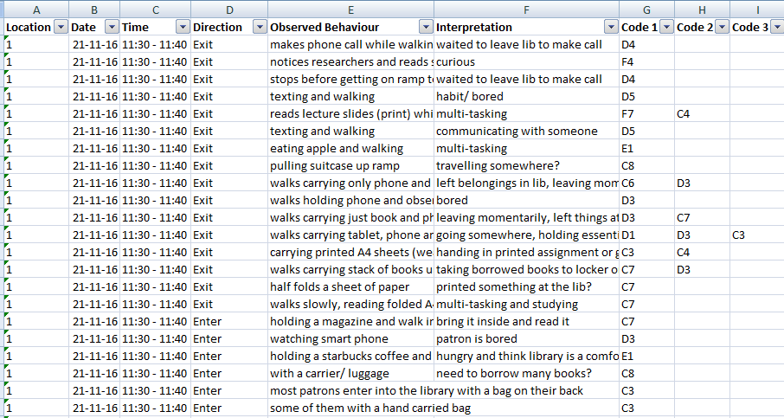
Non-participant Observation: Interpretation
214 observations
Codes grouped into categories: A) Social activities, B) Library services/ facilities, C) Belongings/ objects, D) Technology, E) Food and Drink, and F) Actions
Notes:
Non-participant observation at HKUL

Slide 52
Non-participant Observation: Interpretation
130 minutes of observations 230 minutes of behavioural mapping data collected
Data collected at 5 sites: 1) Main entrance 2) Lounge 3) Self-service collection 4) Exhibition area 5) Service counters
Data collected 11:30am – 12:00pm and 4:30pm – 5:00pm

Slide 53
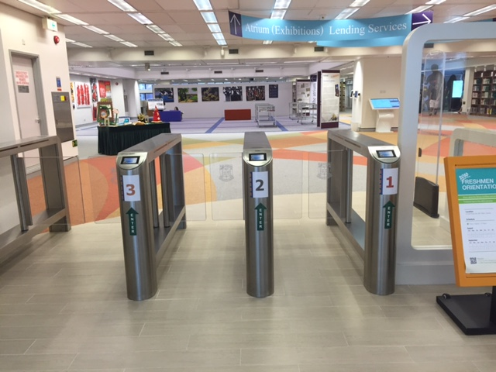
Non-participant Observation: Interpretation
Preliminary findings:
Confirm some information: e.g. users leave belongings in the Library and go for breaks
Some objects many users carry in and out of the Library: water bottles, sheets of paper
The lounge is a social place where users sit and meet their friends
Users often take out their cards or rearrange their belongings in the entrance and lounge: do we need to provide some standing tables for their convenience?
Users are often carrying water bottles: do we need to provide more water dispensers on 2/F?
Users are often carrying loose sheets of paper: could we consider plastic folders as library-branded promotional items?

Slide 54
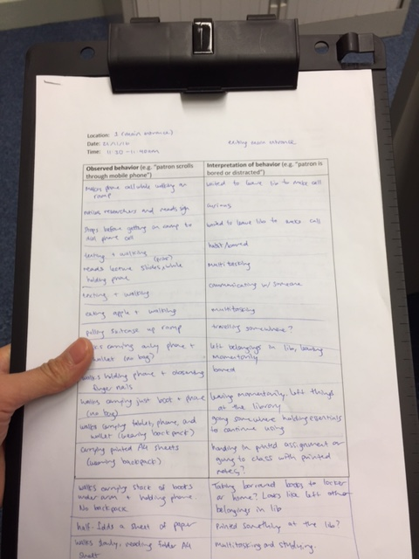
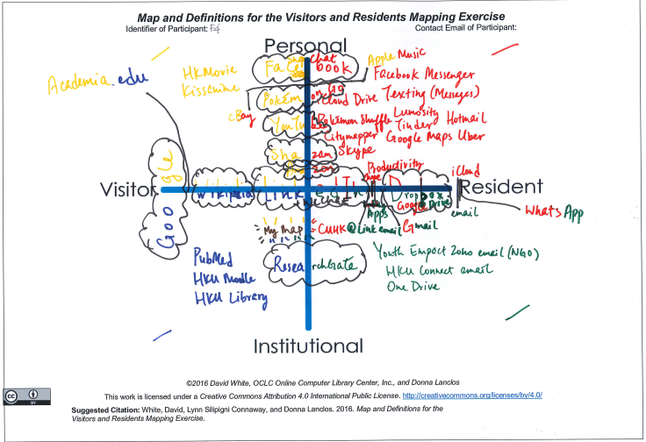
UX Conclusion
User experience research supplements Library statistics to tell us about our users’ behaviour
Many institutions and businesses are conducting user experience research
Non-participant observation and behavioural mapping can teach us about our users
More studies need to be conducted

Slide 55
Sources
Man, Melissa (2017), User Experience Research at HKU Libraries, Powerpoint Presentation to HKU Libraries Staff Forum.
Silipigni Connaway, L., Sidorko, P. And Steel, V. Learning About Users Through the Visitors & Residents Framework: Mapping Engagement with Technology, OCLC APRC, 1-2 December, 2016, Hong Kong.
The University of Hong Kong Libraries (2017), Library User Survey 2017 – Survey Results http://lib.hku.hk/newsblog/?p=911.

Slide 56

THREE Assessment Stories

Slide 57
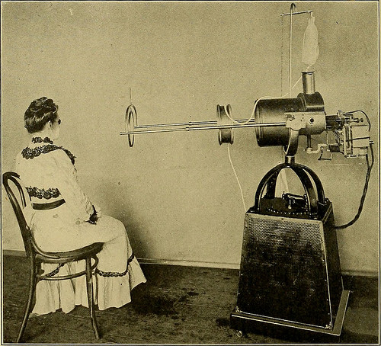
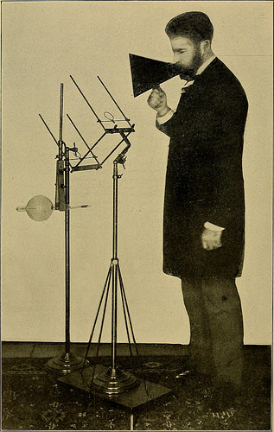
Story #1 - Assessing Learning
https://www.flickr.com/photos/internetarchivebookimages/14754758204/
https://www.flickr.com/photos/internetarchivebookimages/14570521667/

Slide 58
Assessment Types
Satisfaction-based
Confidence-based
Perceived usefulness-based
Learning/competence-based
Think about when to use which

Slide 59
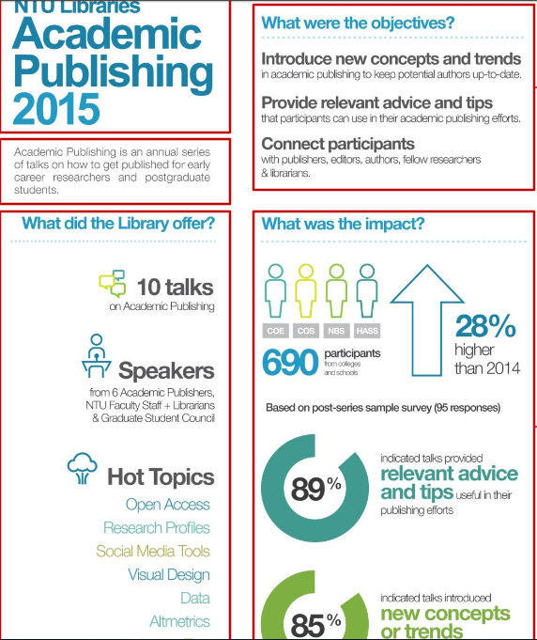
Story #2 - Assessing Impact

Slide 60
Focus of Assessment
IMPORTANT
e.g. contribution to student/faculty success
not how good is library, but how much good does it do
STRATEGIC
Institutional strategic priorities
Library strategic priorities
Be SELECTIVE (don’t overextend)
focus on strategic importance, doability, actionability
From ARL Workshop: Leading a strategic assessment program in a research library

Slide 61
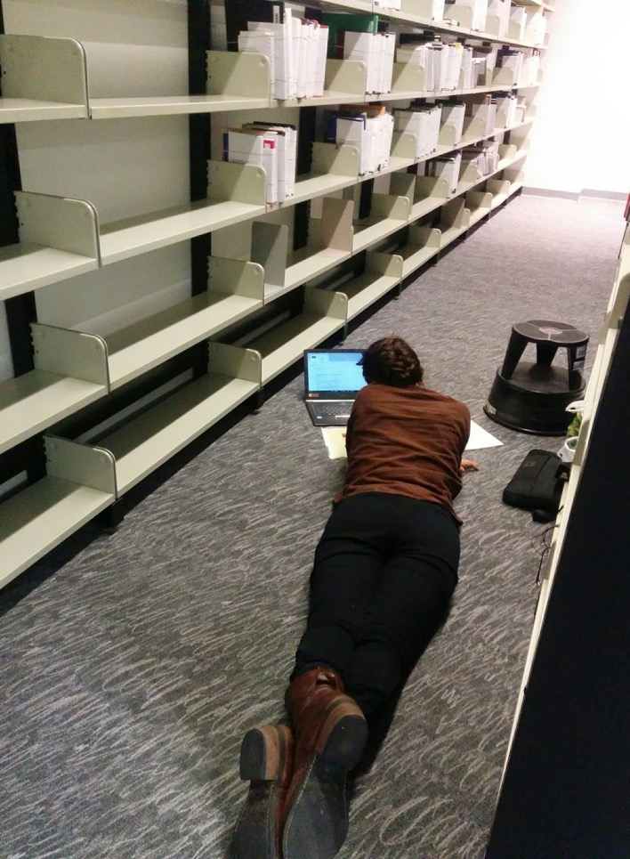
Story #3 - Assessing User Needs

Slide 62
UX Methods
- observation
Observe
Validate observations
Analyze for needs
Brainstorm changes
Implement the chosen few

Slide 63
Consider …
What people outside of Libraries want to know
    Our contribution to student/faculty success
    Our contribution to university mission/visibility
    Accountability/efficiency/effectiveness
    Comparisons with others (peer institutions)
What no one outside the Library wants to know
    How the work is done
    How hard it is to do
    Too much details; too many needs (laundry list)
    Narrative without data; data without narrative
From ARL Seminar: Leading a Strategic Assessment Program in a Research Library

Slide 64
Exercise
Thinking about the “desirable” assessment areas:
- How might the library measure these?
- Are there other areas we should assess?

